Slide 1

Object Oriented Programming
Lec # 2: Pointers

Slide 2
Getting the Address of a Variable
Each variable in program is stored at a unique address
Use address operator & to get address of a variable:
int num = -99;
cout << &num; // prints address
// in hexadecimal

Slide 3
Pointer Variables
Pointer variable : Often just called a pointer, it's a variable that holds an address
Because a pointer variable holds the address of another piece of data, it "points" to the data

Slide 4
Something Like Pointers: Arrays
We have already worked with something similar to pointers, when we learned to pass arrays as arguments to functions.
For example, suppose we use this statement to pass the array numbers to the showValues function: showValues(numbers, SIZE);

Slide 5
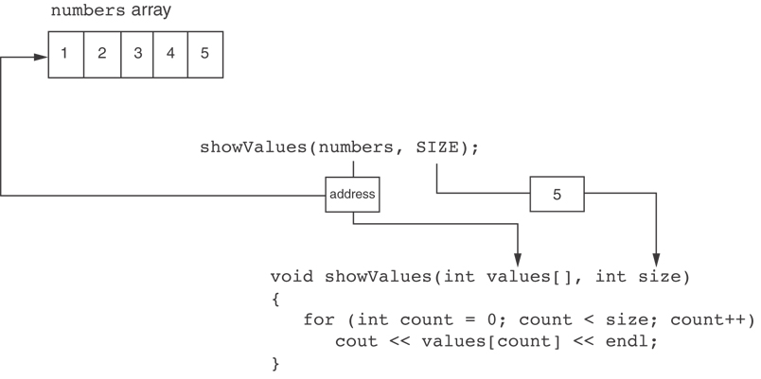
Something Like Pointers : Arrays
The values parameter, in the showValues function, points to the numbers array.
C++ automatically stores the address of numbers in the values parameter.

Slide 6
Something Like Pointers: Reference Variables
We have also worked with something like pointers when we learned to use reference variables. Suppose we have this function:
void getOrder(int &donuts) { cout << "How many doughnuts do you want? "; cin >> donuts; }
And we call it with this code: int jellyDonuts; getOrder(jellyDonuts);

Slide 7
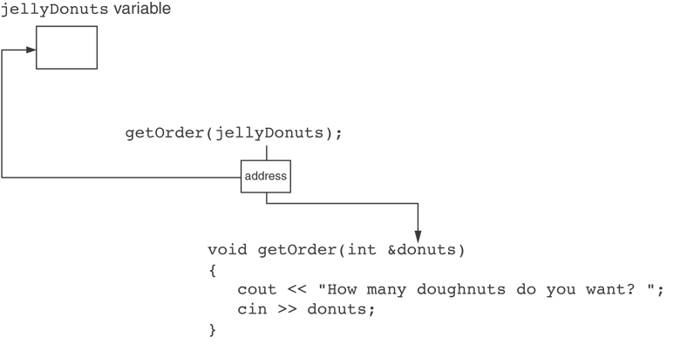
Something Like Pointers: Reference Variables
The donuts parameter, in the getOrder function, points to the jellyDonuts variable.
C++ automatically stores the address of jellyDonuts in the donuts parameter.

Slide 8
Pointer Variables
Pointer variables are yet another way using a memory address to work with a piece of data.
Pointers are more "low-level" than arrays and reference variables.
This means you are responsible for finding the address you want to store in the pointer and correctly using it.

Slide 9
Pointer Variables
Definition:
int *intptr;
Read as:
“intptr can hold the address of an int”
Spacing in definition does not matter:
int * intptr; // same as above
int* intptr; // same as above

Slide 10
Pointer Variables
Assigning an address to a pointer variable:
int *intptr;
intptr = &num;
Memory layout:
num
intptr
25
0x4a00
address of num: 0x4a00

Slide 11
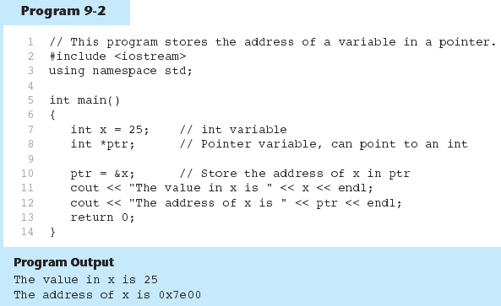
Example

Slide 12
The Indirection Operator
The indirection operator (*) dereferences a pointer.
It allows you to access the item that the pointer points to. int x = 25; int *intptr = &x; cout << *intptr << endl;
This prints 25.

Slide 13
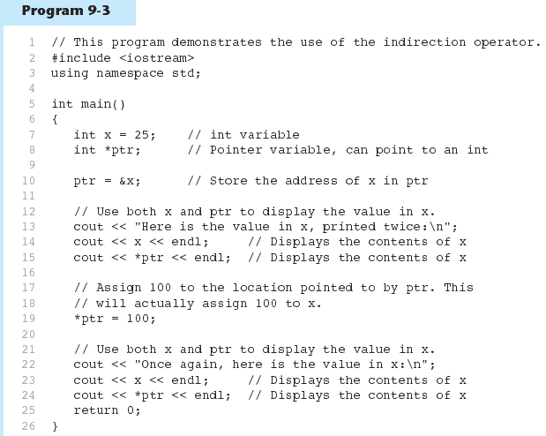
Example

Slide 14
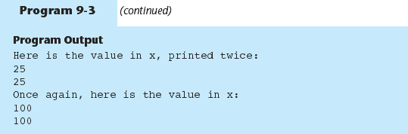
Example

Slide 15
The Relationship Between Arrays and Pointers
Array name is starting address of array
int vals[] = {4, 7, 11};
cout << vals; // displays
// 0x4a00
cout << vals[0]; // displays 4
4 | 7 | 11
starting address of vals: 0x4a00

Slide 16
The Relationship Between Arrays and Pointers
Array name can be used as a pointer constant:
int vals[] = {4, 7, 11};
cout << *vals; // displays 4
Pointer can be used as an array name:
int *valptr = vals;
cout << valptr[1]; // displays 7

Slide 17
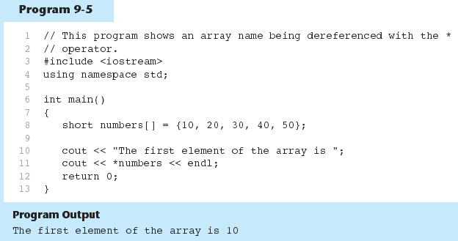
Example

Slide 18
Pointers in Expressions
Given:
int vals[]={4,7,11}, *valptr;
valptr = vals;
What is valptr + 1? It means (address in valptr) + (1 * size of an int)
cout << *(valptr+1); //displays 7
cout << *(valptr+2); //displays 11
Must use ( ) as shown in the expressions

Slide 19
Array Access
Array elements can be accessed in many ways:
Array access method | Example
array name and [] | vals[2] = 17;
pointer to array and [] | valptr[2] = 17;
array name and subscript arithmetic | *(vals + 2) = 17;
pointer to array and subscript arithmetic | *(valptr + 2) = 17;

Slide 20
Array Access
Conversion: vals[i] is equivalent to *(vals + i)
No bounds checking performed on array access, whether using array name or a pointer

Slide 21
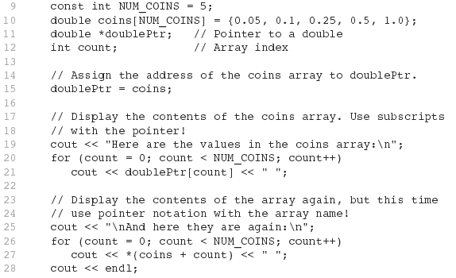
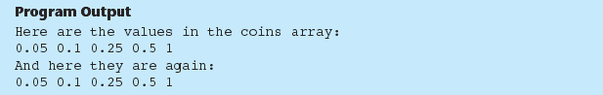
Example

Slide 22
Pointer Arithmetic
Operations on pointer variables
Operation | Example int vals[]={4,7,11}; int *valptr = vals;
++, -- | valptr++; // points at 7 valptr--; // now points at 4
+, - (pointer and int) | cout << *(valptr + 2); // 11
+=, -= (pointer and int) | valptr = vals; // points at 4 valptr += 2; // points at 11
- (pointer from pointer) | cout << valptr–val; // difference //(number of ints) between valptr // and val

Slide 23
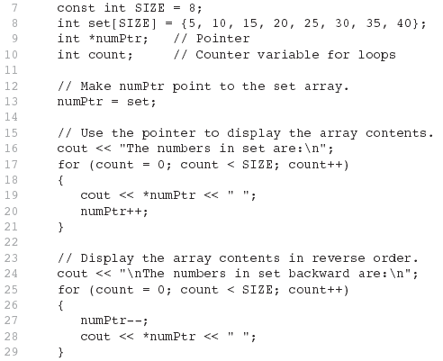
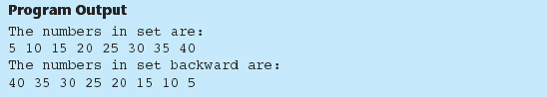
Example

Slide 24
Initializing Pointers
Can initialize at definition time:
int num, *numptr = &num;
int val[3], *valptr = val;
Cannot mix data types:
double cost;
int *ptr = &cost; // won’t work
Can test for an invalid address for ptr with:
if (!ptr) ...

Slide 25
Comparing Pointers
Relational operators (<, >=, etc.) can be used to compare addresses in pointers
Comparing addresses in pointers is not the same as comparing contents pointed at by pointers:
if (ptr1 == ptr2) // compares addresses
if (*ptr1 == *ptr2) // compares contents

Slide 26
Pointers as Function Parameters
A pointer can be a parameter
Works like reference variable to allow change to argument from within function
Requires:
asterisk * on parameter in prototype and heading
void getNum(int *ptr); // ptr is pointer to an int
asterisk * in body to dereference the pointer
cin >> *ptr;
address as argument to the function
getNum(&num); // pass address of num to getNum

Slide 27
Example
void swap(int *x, int *y)
{ int temp;
temp = *x;
*x = *y;
*y = temp;
}
int num1 = 2, num2 = -3;
swap(&num1, &num2);

Slide 28
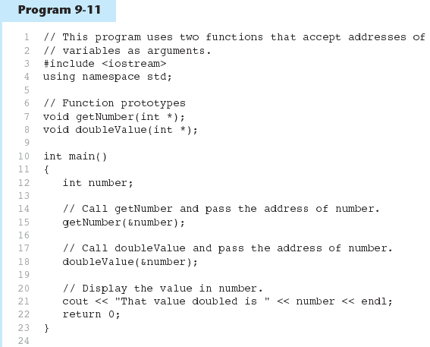
Example

Slide 29
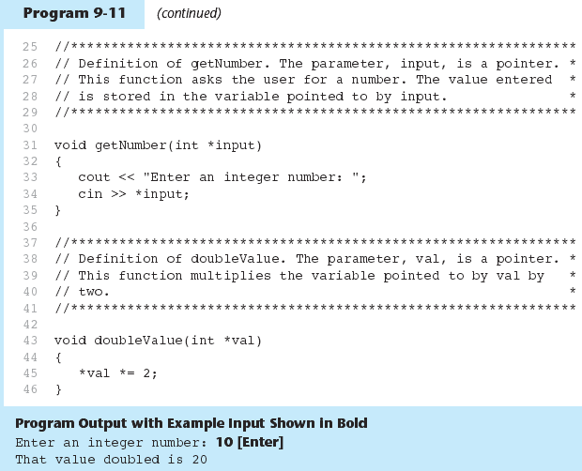
Example

Slide 30
Pointers to Constants
If we want to store the address of a constant in a pointer, then we need to store it in a pointer-to-const.
Example: Suppose we have the following definitions: const int SIZE = 6; const double payRates[SIZE] = { 18.55, 17.45, 12.85, 14.97, 10.35, 18.89 };
In this code, payRates is an array of constant doubles.

Slide 31
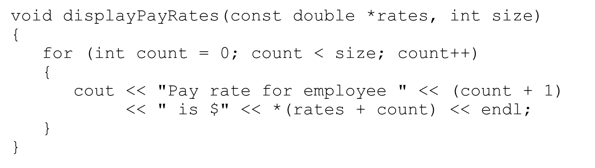
Pointers to Constants
Suppose we wish to pass the payRates array to a function? Here's an example of how we can do it.
The parameter, rates, is a pointer to const double.

Slide 32
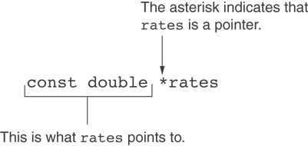
Declaration of a Pointer to Constant

Slide 33
Constant Pointers
A constant pointer is a pointer that is initialized with an address, and cannot point to anything else.
Example const int value = 22; int * const ptr = &value;

Slide 34
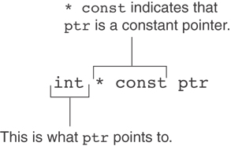
Constant Pointers

Slide 35
Constant Pointers to Constants
A constant pointer to a constant is:
a pointer that points to a constant
a pointer that cannot point to anything except what it is pointing to
Example: int value = 22; const int * const ptr = &value;

Slide 36
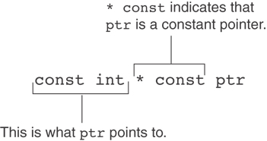
Constant Pointers to Constants

Slide 37
Returning Pointers from Functions
Pointer can be the return type of a function:
int* newNum();
The function must not return a pointer to a local variable in the function.
A function should only return a pointer:
to data that was passed to the function as an argument, or
to dynamically allocated memory

Slide 38
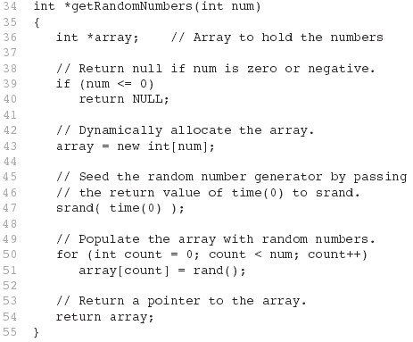
Example

Slide 39
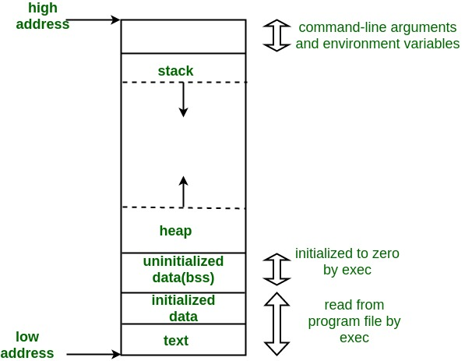
Memory Layout and Pointers

Slide 40
From C++ Code to Process
C++ source code
C++ source files
filename.cpp; .h
Binary files
filename.obj
Executable (Windows)
filename.exe
Process
Managed by OS
compiling
binary files
linking
executable
running
process

Slide 41
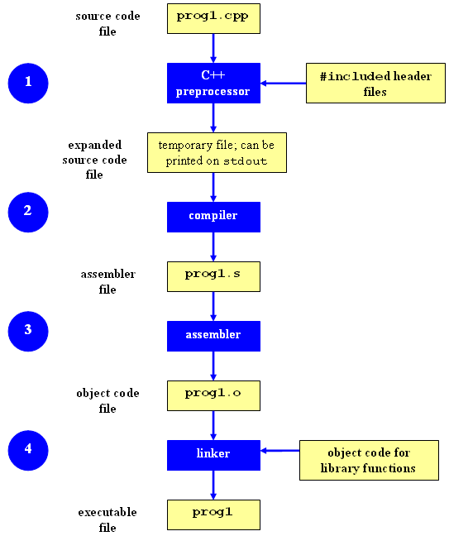

Slide 42
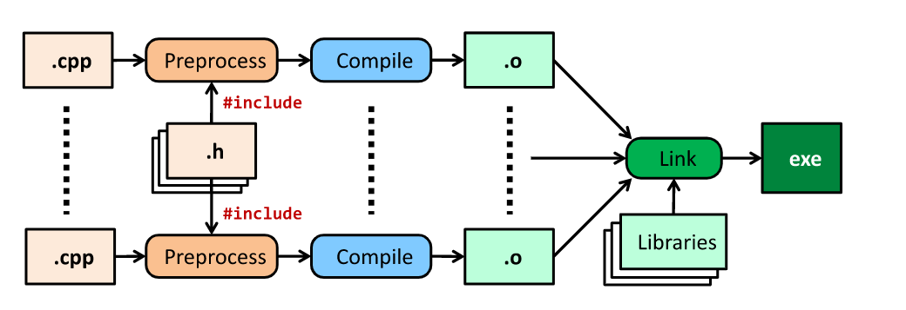
From C++ Code to Process
.h and .cpp files contain source code
Preprocessor performs code substitutions (e.g. #include <iostream>)
Compiler converts expanded source code to object code
Linker links object code file to external libraries (e.g. GLUT) and produces and executable file
Loader brings executable file into memory and starts executing it

Slide 43
C++ Memory Models
C++ leaves memory management mostly up to the programmer
Advantage: write programs that use memory very efficiently
Drawback: write programs that waste memory or do not work at all
For efficient program working, we need good understanding of the memory models

Slide 44
C++ Memory Models
Common errors caused by poor memory management:
Using a variable before it has been initialized
Allocating memory for storage and not deleting it
Using a value after it has been deleted

Slide 45
Main Memory
Network
Audio
CPU
Data Bus
Disk
Video
Memory
shared by all processes

Slide 46
Virtual Memory (How a CPU see’s a Process?)
Continuous memory space for all process:
Set of locations as needed by a process
0
0xffffffff

Slide 47
Revision: Global vs Local Variables
Variables created inside a function are called local variables. Local variables are created when the function is called and deleted once the function ends.
Local variables can only be accessed within the function
//example of local variables
void func(){
int a=10;
float b;
double *ptr;
}

Slide 48
Revision: Global vs Local Variables
Variables created outside functions are called global variables. Global variables are created when the program starts and are deleted once the program ends.
Global variables can be accessed by all functions in the program
//example of global variables
int a = 10;
float b; // variables are not inside any function
double *ptr;
void func(){ …………………… }

Slide 49
Organization of Virtual Memory: .text
Program code and constants
loaded libraries
code instructions
Read-only section to prevent overwriting
space calculated at compile-time
0
text
0xffffffff

Slide 50
Organization of Virtual Memory: Data & BSS
Data: initialized data (global variables and static variables) in the program
E.g: int size = 100;
static int xx = 20;
BSS: un-initialized data (global variables and static variables) in the program
E.g: int length;
static float yy;
0
text
data
bss
0xffffffff

Slide 51
Organization of Virtual Memory: Heap
0
Heap: dynamically-allocated spaces
E.g: new, delete
dynamically grows as program runs
double *ptr = new double;
delete ptr;
text
data
bss
heap
0xffffffff

Slide 52
Organization of Virtual Memory: Stack
Stack: local variables in functions
support function call/return and recursive functions
grow to low address
0
text
data
bss
heap
stack
0xffffffff

Slide 53
Summary: Process Address Space
text: program text/code
data: initialized globals & static data
bss: un-initialized globals & static data
heap: dynamically managed memory
stack: function’s local variables
0
text
data
bss
heap
stack
0xffffffff

Slide 54
Example
char *string = “hello”;
int iSize=8;
float b;
char* f(int x)
{
char *p;
p = new char[iSize];
return p;
}
0
text
data
bss
heap
stack
0xffffffff

Slide 55
Example
char *string = “hello”;
int iSize=8;
float b;
char* f(int x)
{
char *p;
p = new char[iSize];
return p;
}
0
text
data
bss
heap
stack
0xffffffff

Slide 56
Variable Lifetime
text:
program startup
program finish
data, bss:
program startup
program finish
heap:
dynamically allocated
de-allocated (free)
stack:
function call
function return

Slide 57
Dynamic Memory Allocation
Used when space requirements are unknown at compile time
Most of the time the amount of space required is unknown at compile time
Dynamic Memory Allocation (DMA):-
With Dynamic memory allocation we can allocate/deletes memory (elements of an array) at runtime or execution time.

Slide 58
Dynamic Memory Allocation
Can allocate storage for a variable while program is running
Computer returns address of newly allocated variable
Uses new operator to allocate memory:
double *dptr;
dptr = new double;
new returns address of memory location

Slide 59
Dynamic Memory Allocation
Can also use new to allocate array: const int SIZE = 25; double *arrayPtr = new double[SIZE];
Can then use [] or pointer arithmetic to access array:
for(i = 0; i < SIZE; i++)
arrayptr[i] = i * i;
or
for(i = 0; i < SIZE; i++)
*(arrayptr + i) = i * i;
Program will terminate if not enough memory available to allocate

Slide 60
Releasing Dynamic Memory
Use delete to free dynamic memory:
delete fptr;
Use [] to free dynamic array:
delete [] arrayptr;
Only use delete with dynamic memory!

Slide 61
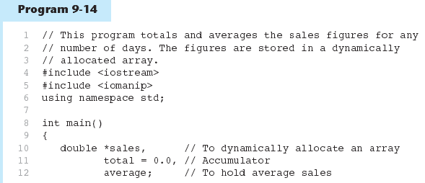
Example

Slide 62
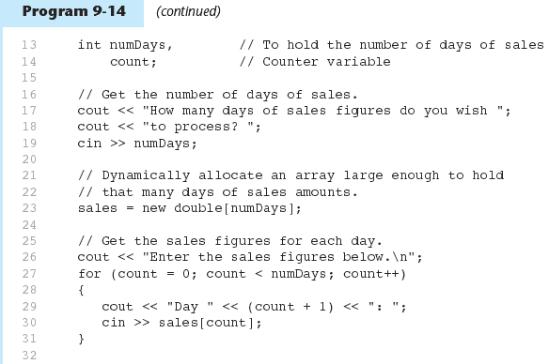
Example

Slide 63
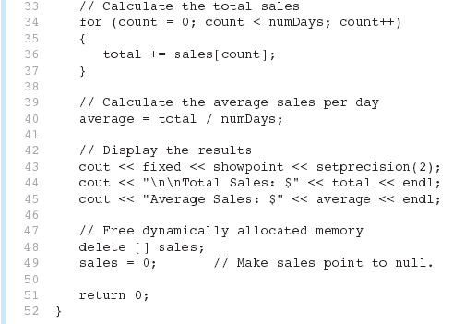
Example

Slide 64
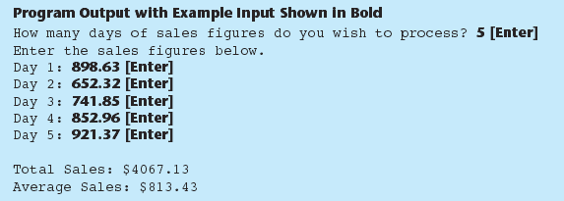
Example
Notice that in line 49 the value 0 is assigned to the sales pointer. It is a good practice to store 0 in a pointer variable after using delete on it. First, it prevents code from inadvertently using the pointer to access the area of memory that was freed. Second, it prevents errors from occurring if delete is accidentally called on the pointer again. The delete operator is designed to have no effect when used on a null pointer.

Slide 65
Differences between Static and Dynamic Memory Allocation
Dynamically allocated memory is kept on the memory heap (also known as the free store)
Dynamically allocated memory cannot have a "name", it must be referred to
Declarations are used to statically allocate memory,
the new operator is used to dynamically allocate memory

Slide 66
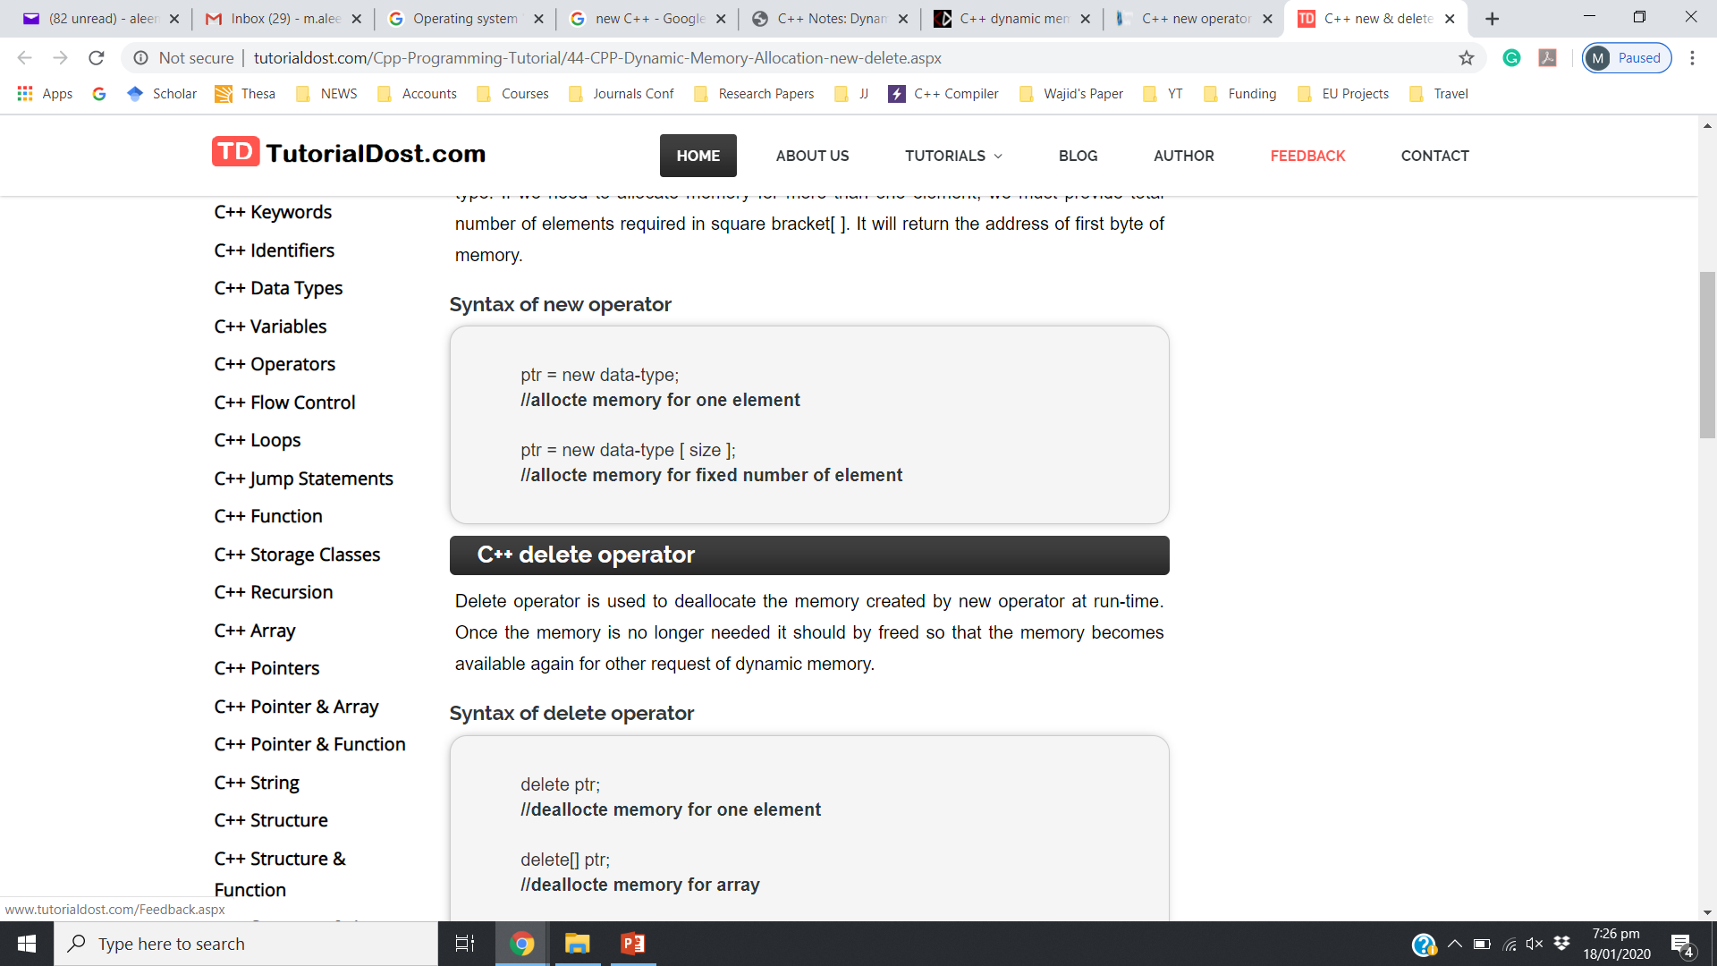
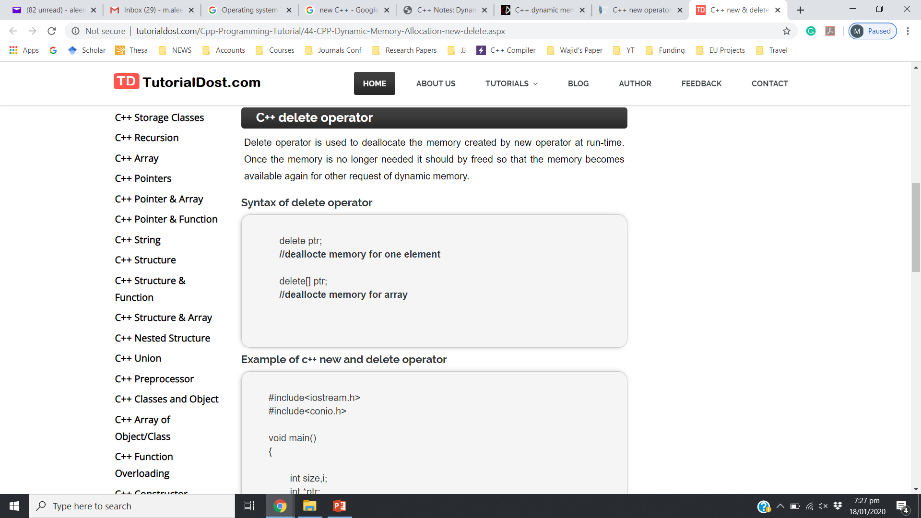
Dynamic Memory Allocation
Heap management in C++ is explicit:

Slide 67
Example
0
text
Recall, variables created inside a function are local variables, they are created after the function is called and deleted from memory once the function ends
int main()
{
int *p;
p = new int;
*p = 99;
return 0;
}
data
bss
heap
#@%*&
p
0xffffffff
stack

Slide 68
Example
0
text
int main()
{
int *p;
p = new int;
*p = 99;
return 0;
}
data
bss
heap
99
p
0xffffffff
stack

Slide 69
Aliasing
0
If two pointers have the same value, they are aliases of each other.
int main()
{
int *p, *q;
p = new int;
*p = 99;
q = p;
return 0;
}
text
data
bss
heap
99
q
p
0xffffffff
stack

Slide 70
Aliasing
0
If two pointers have the same value, they are aliases of each other.
int main()
{
int *p, *q;
p = new int;
*p = 99;
q = p;
*q = 88;
return 0;
}
text
data
bss
heap
88
q
p
0xffffffff
stack

Slide 71
Dangling Pointers
0
text
int main()
{
int *p, *q;
p = new int;
*p = 99;
q = p;
*q = 88;
delete q;
return 0;
}
data
p and q are now dangling pointers but why..?
bss
heap
$%#^&
q
p
0xffffffff
stack

Slide 72
Dangling Pointers
0
text
int main()
{
int *p, *q;
p = new int;
*p = 99;
q = p;
*q = 88;
delete q;
*p = 71;
return 0;
}
data
bss
heap
P and q→ don't point to a valid allocated memory.
$%#^&
q
p
0xffffffff
stack

Slide 73
Dangling Pointers
The delete operator does not delete the pointer, it takes the memory being pointed to and returns it to the heap
It does not even change the contents of the pointer
Since the memory being pointed to is no longer available (and may even be given to another application), such a pointer is said to be dangling

Slide 74

Errors due to Dangling Pointers
If the program writes to memory referenced by a dangling pointer, a silent corruption of unrelated data may result, leading to subtle bugs that can be extremely difficult to find

Slide 75
Avoiding a Dangling Pointer
For Variables:
delete v1;
v1 = NULL;
For Arrays:
delete[ ] arr;
arr = NULL;

Slide 76
Returning Memory to the Heap
Most applications request memory from the heap when they are running;
It is possible to run out of memory (you may even have gotten a message like "Running Low On Virtual Memory")
So, it is important to return memory to the heap when you no longer need it

Slide 77
Returning Memory to the Heap
Always return memory to the heap before undangling the pointer
What happens if you don’t?
ptr = NULL;
delete ptr;
Memory Leak!!!

Slide 78
Memory Leaking
int main()
{
int *p;
p = new int;
// memory allocated above is unreachable now
p = new int;
return 0;
}

Slide 79
Memory Leaking
void f()
{
int *p;
p = new int;
return;
}
int main()
{
f();
return 0;
}
p is a local variable, destroyed after function returns

Slide 80
Memory Leaks
Memory leaks when it is allocated from the heap using the new operator but not returned to the heap using the delete operator

Slide 81
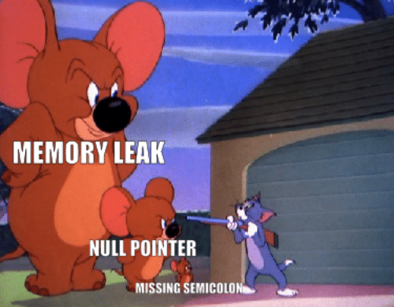
Memory Leaking and Dangling Pointers
Dangling pointers and memory leaking are evil sources of bugs:
Hard to debug
may appear after a long time of run
may far from the bug point
Difficult to prevent

Slide 82
Null Address
Like a local variable, a pointer is assigned a random value (i.e., address) if not initialized
0 is a pointer constant that represents the empty or NULL address
Should be used to avoid dangling pointers
int *ptr = 0; OR int *ptr = NULL;

Slide 83
Null Address
Like a local variable, a pointer is assigned a random value (i.e., address) if not initialized
Cannot Dereference a NULL Pointer
int *ptr = 0;
cout << *ptr << endl;
// ERROR: ptr does not point to a valid //address

Slide 84
Pointers Data-Type
Why does a pointer need a data type?
Aren’t all memory addresses of the same length?

Slide 85
Pointers Type
In a given OS, all memory addresses are of the same length
However, with operations like dereference or increment/decrement the compiler needs to know the data type of the pointer variable (to get data or jump to the next memory location)
Examples:
If “p” is a character-pointer then “p++” will increment “p” by one byte (next location)
if “p” is an integer-pointer its value on “p++” would be incremented by 4 bytes (next loc.)

Slide 86
Void Pointer
void* is a pointer with no type:
void * can point at any type of data
int iVar=5;
float fVar=4.3;
char cVar=‘Z’;
int* p1;
void* vp2;
p1 = &iVar; // Allowed
p1 = &fvar; // Not Allowed
P1 = &cVar; // Not Allowed
vp2 = &fvar; // Allowed
vp2 = &cVar; // Allowed
vp2 = &iVar; // Allowed

Slide 87
Void Pointers
Cannot be dereferenced
Cannot perform any arithmetic operations, not even increment/decrement

Slide 88
Pointer Assignments (Aliasing)
Some care is required making assignments to pointer variables:
p1= p2; // changes the location that p1 "points" to
*p1 = *p2; // changes the value at location that // p1 "points" to

Slide 89
Another Pointer Example
int i = 1;
int j = 2;
int* ptr;
ptr = &i; // ptr points to location of i
*ptr = 3; // contents of i are updated
ptr = &j; // ptr points to location of j
*ptr = 4; // contents of j are updated
cout << i << " " << j << endl;
Output:3
4

Slide 90
Casting pointers
Pointers have types, so you cannot just do this
int *pi;
double *pd;
pd = pi;
Even if they are both the same size, C++ will still give an error on implicit typecasting

Slide 91
Casting pointers
C++ will let you change the type of a pointer with an explicit cast
int *pi; char *pd;
pd = (char*) pi;

Slide 92
Casting pointers
C++ will let you change the type of a pointer with an explicit cast
int *pi = new int;
*pi = 65;
char *pd;
pd = (char*) pi;
cout<<*pd;
//prints A (ascii 65)

Slide 93
Casting pointers
int *pi = new int; //size 4 bytes
*pi = 131072;
00000000 00000010 00000000 00000000
byte 4 byte 3 byte 2 byte 1
short *pd;
pd = (short*) pi;
cout<<*pd;
//Prints 0 (short size 2 bytes)

Slide 94
Pointer Arithmatic
int x = 25; int *intptr = &x;
intptr++;
What happens now?
Pointer address increases by 4 bytes because the pointer is of type int
Same as intptr + 1

Slide 95
Pointer Arithmetic
int x = 25; int *intptr = &x;
intptr++;
e.g. address of x was 4000
intptr will now be 4004

Slide 96
Pointer Arithmetic

Slide 97
Pointer Arithmetic
int x = 25; int *intptr = &x;
Can we increment the value of x using the pointer?
(*intptr)++;
* Gets the value the pointer points at.
Value of x becomes 26
Brackets needed because * has lower precedence

Slide 98
Pointer Arithmetic
Only two types of arithmetic operations allowed:
Addition : only integers can be added
Subtraction: only integers be subtracted

Slide 99
Relationship Between Pointers and Arrays
Arrays and pointers are closely related
Array name is a constant pointer that stores the starting address of an array
All arrays elements are placed in the consecutive locations

Slide 100
Arrays and Pointers
Array name is the starting address of the array
int A[25]; int *p; int i=0, j=0;
p = A;
p points to A[0]
p + i points to A[i] &A[j]is also the same as p+j A[j] is also the same as *(p+j)

Slide 101
Arrays Decay to Pointers
We learned to pass arrays as arguments to functions
For example, suppose we use this statement to pass the array numbers to the showValues function: showValues(numbers, SIZE);

Slide 102
Arrays Decay to Pointers
Arrays passed by value decay into a pointer.
Cannot find size using sizeof() and must pass size as a function parameter
The values parameter, in the showValues function, points to the numbers array.
C++ automatically stores the address of numbers in the values parameter.

Slide 103
Arrays Decay to Pointers
Using sizeof() on an array passed by value to a function will return the size of the pointer
The values parameter, in the showValues function, points to the numbers array.
C++ automatically stores the address of numbers in the values parameter.

Slide 104
Accessing 1-Dimensional Array Using Pointers
Address
Data
980
Element 0
We know, Array name denotes the memory address of its first slot.
Example:
int List [ 50 ];
int *Pointer;
Pointer = List;
Other slots of the Array (List [50]) can be accessed using by performing Arithmetic operations on Pointer.
For example the address of (element 4th) can be accessed using:-
int *Value = Pointer + 3;
The value of (element 4th) can be accessed using:-
int Value = *(Pointer + 3);
984
Element 1
988
Element 2
992
Element 3
996
Element 4
1000
Element 5
1004
Element 6
1008
Element 7
1012
Element 8
…
…
…
Element 49

Slide 105
Accessing 1-Dimensional Array
Address
Data
980
Element 0
….
….
int List [ 50 ];
int *Pointer;
Pointer = List; // Address of first Element
int *ptr;
ptr = Pointer + 3; // Address of 4th Element
*ptr = 293; // 293 value store at 4th element address
}
984
Element 1
988
Element 2
992
293
996
Element 4
1000
Element 5
1004
Element 6
1008
Element 7
1012
Element 8
…
…
…
Element 49

Slide 106
Accessing 1-Dimensional Array
We can access all element of List [50] using Pointers and a for loop
Address
Data
980
Element 0
984
Element 1
int List [ 50 ];
int *Pointer;
Pointer = List;
for ( int i = 0; i < 50; i++ )
{
cout << *Pointer;
Pointer++; // Address of next element
}
988
Element 2
992
Element 3
996
Element 4
1000
Element 5
1004
Element 6
1008
Element 7
1012
Element 8
…
…
…
Element 49
This is Equivalent to
for ( int index = 0; index < 50; index++ )
cout << Array [ index ] ;

Slide 107
Dynamic Memory Allocation
Can also use new to allocate array:
int SIZE = 25; double *arrayPtr = new double[SIZE];
Can then use [] or pointer arithmetic to access array:
for(int i = 0; i < SIZE; i++)
arrayptr[i] = i;
or
for(int i = 0; i < SIZE; i++)
*(arrayptr + i) = i;
Program will terminate if not enough memory available to allocate

Slide 108
// Dynamically allocate memory for 1d array
int N, i;
N = 15;
// Dynamically allocate memory of size N
int *array = new int[N];
// Assign values of allocated memory
for(i = 0; i < N; i++){
cin >> *(array+i); }
for(i = 0; i < N; i++){
cout<<array[i]<<" "; // is equal to cout<<*(array+i);
delete [] array; //deallocate memory

Slide 109
// Dynamically allocate memory for 1d array
int N, i;
cout<<"Enter size of array: ";
cin >> N; //get size from user
// Dynamically allocate memory of size N
int *array = new int[N];
// Assign values of allocated memory
for(i = 0; i < N; i++){
cin >> *(array+i); }
for(i = 0; i < N; i++){
cout<<array[i]<<" "; // is equal to cout<<*(array+i);
delete [] array; //deallocate memory

Slide 110
Accessing 2-Dimensional Array
Address
Data
Note that the statements
int *Pointer;
Pointer = &List [3];
represents that we are accessing the address of 4th slot
In 2-Dimensional array the statements
int List[ 5 ][ 6 ];
int *Pointer;
Pointer = &List [3];
Represents that we are accessing the address of 4th row and 1st column
980
Element 0
984
Element 1
988
Element 2
992
Element 3
996
Element 4
1000
Element 5
1004
Element 6
1008
Element 7
1012
Element 8
…
…
…
Element 49

Slide 111
Accessing 2-Dimensional Array
Column
int List [ 9 ] [ 6 ];
int *ptr;
ptr = &List [3];
To access the address of 4th row 2nd column:
ptr++; // address of 4th row 2nd column
Equivalent to List [3][1] ;
0
1
2
3
4
5
0
300
302
304
306
308
310
Row
1
312
314
316
318
320
322
2
324
326
328
330
332
334
3
336
338
340
342
344
346
4
348
350
352
354
356
358
5
360
362
364
366
368
370
6
372
374
376
378
380
382
7
384
386
388
390
392
394
8
396
398
400
402
404
406
Row Index

Slide 112
Creating Dynamic 2D Arrays
Two basic methods:
Using Only one Pointer/One array
Using an Array of Pointers

Slide 113
Dynamic two-dimensional arrays
Using One Pointer/One array
Total elements in a 2D Array:
M * N (i.e., rows * cols)
5 rows * 4 columns = 20 elements
Approach:
Allocate 20 elements using dynamic allocation
Use a pointer to point and access those items

Slide 114
Accessing 2-Dimensional Array
Access static array elements using a pointer
int arr[9]={ 1,2,3,
4,5,6,
7,8,9};
int *p = &arr[0];
*(p +(TotCols * rowIndx)+ colIndx);
//equivalent to arr[1][1]
cout<<*(p +(3 * 1)+ 1); //prints 5
//equivalent to arr[2][2]
cout<<*(p +(3 * 2)+ 2); //prints 9

Slide 115
Accessing 2-Dimensional Array
Access dynamic array elements using a pointer
int *p = new int[3 * 3];
for(int i=0;i<9;i++){
p[i] = i+1;
}
*(p +(TotCols * rowIndx)+ colIndx);
//equivalent to arr[1][1]
cout<<*(p +(3 * 1)+ 1); //prints 5
//equivalent to arr[2][2]
cout<<*(p +(3 * 2)+ 2); //prints 9

Slide 116
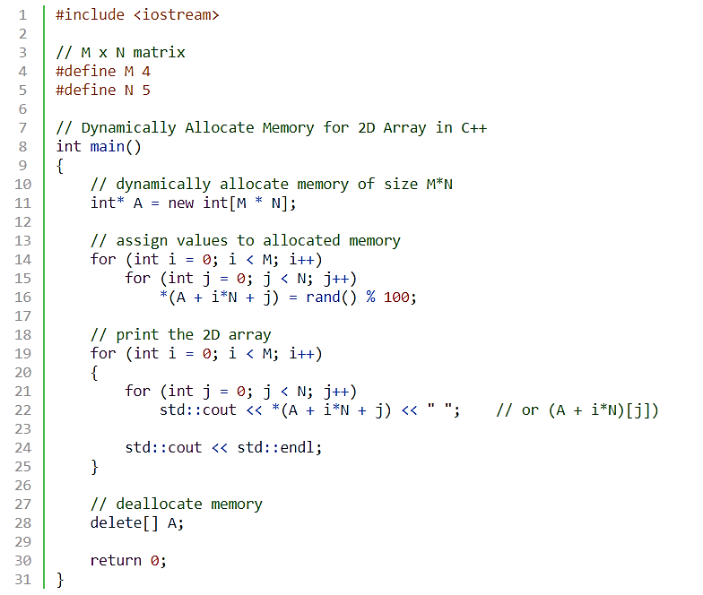
Dynamic 2D Arrays
Notes:
int main(){
int *p= new int[5];
for(int i =0; i<5;i++)
cin>>*(p+i);
for(int i =0; i<5;i++)
cout<<" "<<p[i];
return 0;}

Slide 117
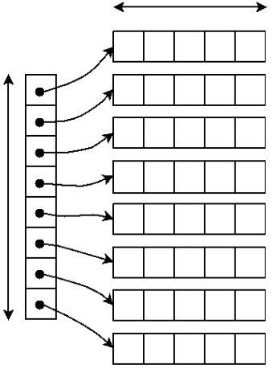
Dynamic 2D Array – Double Pointer
Using a Pointer that points to an Array of Pointer
Total elements in a 2D Array:
M * N i.e (rows * columns)
N
Ptr2D
(Pointer to a Pointer a.k.a double pointer)
M

Slide 118
Dynamic 2D Array – Double Pointer
arr → start of array of pointers
*arr → First Address pointed by first row (sub array)
*(*arr) → First value of first array
(*arr)++ → Move to next address in the first array
arr++ → Move to Next row (second array address)
int M=3, N=4;
// Dynamically create array of pointers of size M
int **arr = new int*[M];
// Dynamic allocate memory of size N for each row
for(int i = 0; i < M; i++){
arr[i] = new int[N]
}
// deallocate memory
for(int i = 0; i < M; i++){
delete[] arr[i]; }
delete[] arr;
Can we vary the size of each column in Dynamic 2D Array (using double pointer)
**
*
*
*
Notes:
The bracket operator is implemented by computing the address of the ith object
base = A = address of A[0] address of element i = base + offset = base + i * sizeof(T) A[i] = reference to element at this address Pointer must know its type to compute addresses using sizeof(T)
Note carefully the distinction between A and A[0]

Slide 119
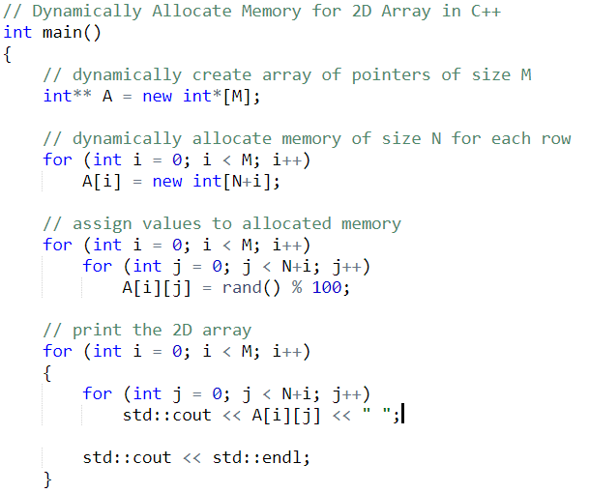
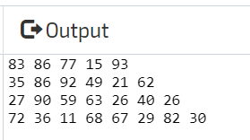
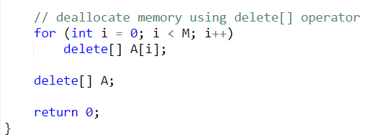
Dynamic 2D Array (Varying Row Size)

Slide 120
Access Dynamic 2D Array Elements
Square bracket notation
arrName[rowIndex][ColIndex]
Dereference operator notation
*(*(arrName + rowIndex) + colIndex)

Slide 121
Access Dynamic 2D Array Elements
Square bracket notation
for(int i=0; i<rows; i++){
for(int j=0; j<columns; j++){
cout<< arrName[i][j];
}
}

Slide 122
Access Dynamic 2D Array Elements
Dereference operator notation
for(int i=0; i<rows; i++){
for(int j=0; j<columns; j++)
cout<< *(*(arrName + i) + j);
}
}

Slide 123
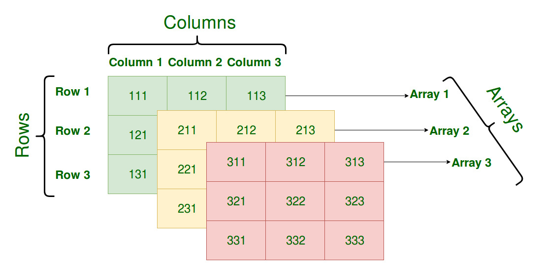
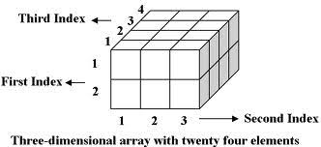
Dynamic 3D Array
Manipulating a 3D Array
Using one pointer
Using a triple pointer

Slide 124
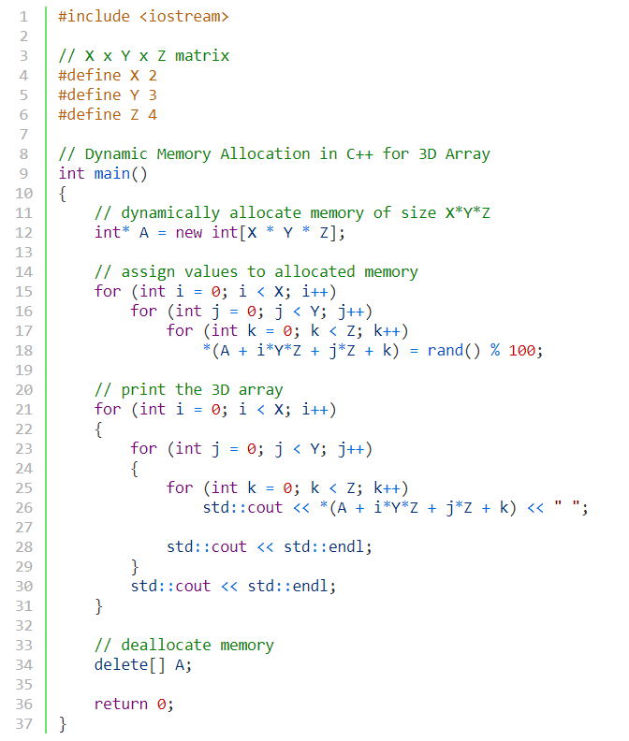
3D Array Using a single pointer
X number of 2D arrays
Y number of rows in 2D array
Z number of columns in 2D array
*(A + arrayIndex*TotalRows*TotalCols + rowIndex*TotalCols + colIndex)

Slide 125
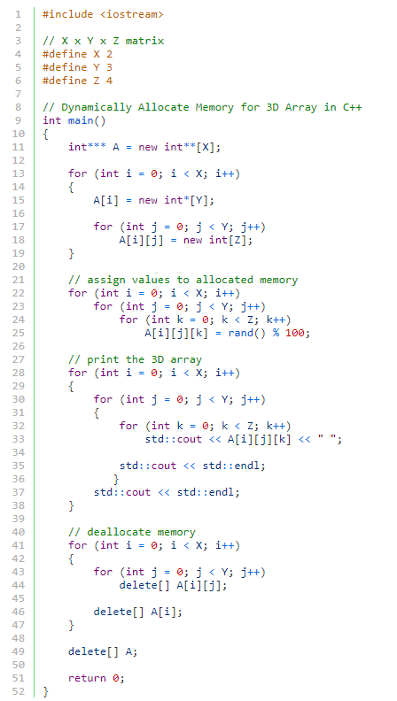
3D Array Using a triple pointer
***
3D array of size 2 x 3 x 4
** | **
*
*
*
*
*
*

Slide 126
Access Dynamic 3D Array Elements
Square bracket notation
arrName[arrIndex][rowIndex][ColIndex]
Dereference operator notation
*(*(*(arrName + arrIndex) + rowIndex)+ colIndex)

Slide 127
Access Dynamic 3D Array Elements
Square bracket notation
for(int i=0; i<arrays; i++){
for(int j=0; j<rows; j++){
for(int k=0; k<colums; k++){
cout<< arrName[i][j][k];
}
}
}

Slide 128
Access Dynamic 3D Array Elements
Square bracket notation
for(int i=0; i<arrays; i++){
for(int j=0; j<rows; j++){
for(int k=0; k<colums; k++){
cout<< *(*(*(arrName + i) + j)+ k);
}
}
}

Slide 129
C - Strings
#include <string> VS #include <string.h> #include <cstring>
String class C language header file
Stores strings as char arrays

Slide 130
C - Strings
In C++, a C-string is a sequence of characters stored in consecutive memory locations (array), terminated by a null character.
string name= “Bailey”;
\0 is the NULL character
B | a | i | l | e | y | \0
0 1 2 3 4 5 6

Slide 131
Character Arrays
Be careful, every character array is not a string, however the behavior is similar
char name[7]= {‘B’,’a’,’i’,’l’,’e’,’y’,’y’};
B | a | i | l | e | y | y
0 1 2 3 4 5 6

Slide 132
Character Arrays
Character array initialized with string literal
char name[7]=“Bail”; //always stores \0 at the end
If initializer values of a char array are less than array size, remaining filled with null character – can treat array like a string
B | a | i | l | \0 | \0 | \0
0 1 2 3 4 5 6

Slide 133
Character Arrays
Character array initialized with string literal
char name[]=“Bailey”; //always stores /0 at the end
Array size not specified, char array size = number of characters in string literal + 1 (for \0)
B | a | i | l | e | y | \0
0 1 2 3 4 5 6

Slide 134
Character Arrays
Be careful, every character array is not a string
char name[4]=“Bail”; //always stores \0 at the end
Array size is 4, characters to store are also 4, no space for NULL character – ERROR!!
B | a | i | l | \0
0 1 2 3 4

Slide 135
Character Arrays
char name[]=“Bail”; //always stores \0 at the end
cout<< name; //what happens now?
//Prints Bail
The char array is treated as a string and cout prints characters from the starting address of the array till the null character
B | a | i | l | \0
0 1 2 3 4

Slide 136
Character Arrays
char name[4] = {‘B’,’a’,’i’,’l’};
cout<< name; //what happens now?
//Prints Bail
The char array is treated as a string and cout prints characters from the starting address of the array till the end
B | a | i | l
0 1 2 3

Slide 137
Character Arrays
char name[4] = {‘B’,’a’,’i’,’l’};
cout<< (name+1); //what happens now?
//Prints ail
The char array is treated as a string and cout prints characters from the starting address till the end
B | a | i | l
0 1 2 3

Slide 138
Character Arrays
char name[4] = {‘B’,’a’,’i’,’l’};
cout<< name[2]; //what happens now?
//Prints i
B | a | i | l
0 1 2 3

Slide 139
Character Arrays
char name[4] = {0};
Always initialize your character array with 0, puts null terminator in all array elements, prevents garbage values.
\0 | \0 | \0 | \0
0 1 2 3

Slide 140
Character Arrays
char name[4] = {0};
name[0]=‘h’;
name[1]=‘i’;
Always initialize your character array with 0, puts null terminator in all array elements, prevents garbage values
cout<<name; //prints hi
h | i | \0 | \0
0 1 2 3

Slide 141
Character Arrays and Char Pointer
* * *
* *
*
* *
* * *
char arr[] = "****";
int i = 1;
for (; i < 3; i++) {
cout << (arr+i) << endl;
}
for (; i >= 1; i--) {
cout << (arr + i) << endl;
}

Slide 142
Character Arrays and Char Pointer
char name[]=“Bail”; //always stores /0 at the end
char *ptr = name;
cout<< ptr; //what happens now?
//Prints Bail
cout prints characters from the pointer address till the null character
B | a | i | l | \0
0 1 2 3 4

Slide 143
Character Arrays and Char Pointer
char name[]=“Bail”; //always stores /0 at the end
char *ptr = name;
ptr++;
cout<< ptr;
cout prints characters from the starting address of the array till the null character, print ail
B | a | i | l | \0
0 1 2 3 4

Slide 144
Character Arrays and Char Pointer
char name[]=“Bail”; //always stores /0 at the end
char *ptr = name;
cout<< ptr[2];
cout prints character at index 2, prints i
B | a | i | l | \0
0 1 2 3 4

Slide 145
Character Arrays and Char Pointer
char name[]=“Bail”; //always stores /0 at the end
char *ptr = name;
ptr++;
cout<< *(ptr + 2);
cout prints character at index 2, prints l
B | a | i | l | \0
0 1 2 3 4

Slide 146
Character Arrays and Char Pointer
void match(char* str, char ch, int size){
for(int i=0;i<size;i++){
if(*str == ch){
cout << str;
break;
}
else
str++; }}
void main() {
char arr[] = "some string";
match(arr,'e',sizeof(arr));
}
e string

Slide 147
Character Arrays and Char Pointer
// Copying string using Pointers
const char* str1 = “Self-conquest is the greatest victory.”;
char str2[80]={0}; //empty string
char* src = str1;
char* dest = str2;
while( *src ) //until null character,
*dest++ = *src++; //copy from src to dest
*dest = ‘\0’; //terminate dest
cout << str2 << endl; //display str2

Slide 148
Cin vs Getline
Input can be performed by the cin object.
const int SIZE = 21;
char name[SIZE];
cin >> name;
This code allows the user to enter a string (with no whitespace characters) into the name array

Slide 149
Cin vs Getline
C-string input can be performed by the getline function of the cin object.
const int SIZE = 21;
char name[SIZE];
cin.getline(name, SIZE);
This code allows the user to enter a string (with whitespace characters) into the name array

Slide 150
Cin vs Getline
const int SIZE = 21;
char name[SIZE];
cin.getline(name, SIZE);
first argument tells getline where to store the string input.
second argument indicates maximum length of the string, including the null terminator

Slide 151
Cin vs Getline
const int SIZE = 21;
char name[SIZE];
cin.getline(name, SIZE);
In this example, the SIZE constant is equal to 21,
cin will read 20 characters, or until the user presses the Enter key, whichever comes first.
cin will automatically append the null terminator to the end of the string.

Slide 152

Cin vs Getline
const int SIZE = 21;
char name[SIZE];
cin.getline(name, SIZE);
If you are using cin and cin.getline together, you would have to clear the input buffer inbetween, to remove the null character inserted by cin
Use cin.ignore(); for this.

Slide 153
Cin vs Getline
If you are using cin and cin.getline together, you would have to clear the input buffer inbetween
Use cin.ignore(); for this.
int x, arr[3];
cin>>x;
cin.ignore(); //clears the input stream buffer
cin.getline(arr,3);

Slide 154
char* and const
const char *ptr : This is a pointer to a constant character. You cannot change the value pointed by ptr, but you can change the pointer itself. “const char *” is a (non-const) pointer to a const char.
char *const ptr : This is a constant pointer to non-constant character. You cannot change the pointer p, but can change the value pointed by ptr.
const char * const ptr : This is a constant pointer to constant character. You can neither change the value pointed by ptr nor the pointer ptr.

Slide 155
C-String and Char Pointer
A String: is simply defined as an array of characters
char* s; // s is the address of the first character (byte) of the string
A valid C string ends with the null character ‘\0’
Direct initialization char* <string Literal>;
char* s=“FAST”;
cout<<s<<sizeof(s);
cout<<++s<<sizeof(s);

Slide 156
char [] VS. char *
char A[20]=“FAST”; char* P=“FAST”;
A is an Array
A++; //invalid
sizeof(A) → 20 Characters or bytes
A and &A points to same memory
address
5) A=“PAKISTAN”; //invalid
A is an address, “PAKISTAN” is the start address where “PAKISTAN” string is stored in memory.
6) A[0]=‘p’; //Valid
7) A is stored in stack
P is a pointer variable
P++; //Valid
Sizeof(P) → 4 Characters or bytes
P points to start address where characters are stored, and &P points to address of pointer variable.
P=“PAKISTAN” //valid
P[0]=‘p’; //inValid
P is stored in Stack, “FAST” is stored in “Text” section (Read-only)

Slide 157
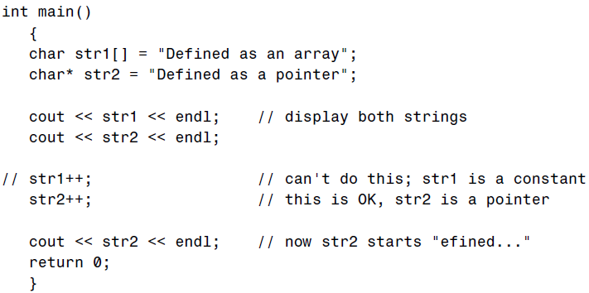
C-String and Char Pointer

Slide 158
C-String and Char Pointer
// Copying string using Pointers
char* str1 = “Self-conquest is the greatest victory.”;
char str2[80]; //empty string
char* src = str1;
char* dest = str2;
while( *src ) //until null character,
*dest++ = *src++; //copy chars from src to dest
*dest = ‘\0’; //terminate dest
cout << str2 << endl; //display str2

Slide 159
Pointers as Function Parameters
n = 5 | 2000
num = 2000 | 2400
void func(int *num)
{
*num = 10;
}
void main()
{ int n = 5;
cout<<"Before: n = "<<n<<endl;
func(&n);
cout<<"After: n = "<<n<<endl;
}

Slide 160
Pointers as Function Parameters
n = 5 | 2000
num = 2000 | 2400
void func(int *num)
{
*num = 10;
}
void main()
{ int n = 5;
cout<<"Before: n = "<<n<<endl;
func(&n);
cout<<"After: n = "<<n<<endl;
}

Slide 161
Pointers as Function Parameters
n = 10 | 2000
num = 2000 | 2400
void func(int *num)
{
*num = 10;
}
void main()
{ int n = 5;
cout<<"Before: n = "<<n<<endl;
func(&n);
cout<<"After: n = "<<n<<endl;
}

Slide 162
Pointers as Function Parameters
n = 10 | 2000
 | 2400
void func(int *num)
{
*num = 10;
}
void main()
{ int n = 5;
cout<<"Before: n = "<<n<<endl;
func(&n);
cout<<"After: n = "<<n<<endl;
}
Before: n = 5
After: n = 10

Slide 163
Pointers as Function Parameters
Do not use & while passing an array
Array name is already an address
void compDouble(int* Ar)
{
…………… }
void main()
{ int Arr[10]={0,1,2,3,4,5,6,7,8,9};
compDouble(&Arr); //ERROR
}

Slide 164
Pointers as Function Parameters
Do not use & while passing an array
Array name is already an address
void compDouble(int* Ar)
{
…………… }
void main()
{ int Arr[10]={0,1,2,3,4,5,6,7,8,9};
compDouble(Arr); //Correct way
}

Slide 165
Pointers as Function Parameters
void compDouble(int* Ar)
{ for(int i=0;i<10;i++)
{ *Ar=(*Ar)*2;
Ar++;
} }
void main()
{ int Arr[10]={0,1,2,3,4,5,6,7,8,9};
compDouble(Arr);
}

Slide 166
Pointers as Function Parameters
A function with a pointer parameter, called with pointer argument
Case 1: If you change the value at the address the pointer points to, the change will remain even after the function has returned
Case 2: If you change the value of the pointer (address), the change will not be retained after the function ends
This is because the function has a copy of the pointer

Slide 167
Case 1 Example
void func(int *num)
{
*num = 30;
}
void main()
{ int n = 5; int *p = &n;
cout<<"Before: n = "<<n<<endl;
func(p);
cout<<"After: n = "<<n<<endl;
}
Before: n = 5
After: n = 30

Slide 168
Case 2 Example
int gl = 93;
void func(int *num)
{
num = &gl;
}
void main()
{ int n = 5; int *p = &n;
cout<<"Before: n = "<<n<<endl;
func(p);
cout<<"After: n = "<<n<<endl;
}
Before: n = 5
After: n = 5

Slide 169

Pointers as Function Parameters
Two ways to change the value of a pointer (address) in a function with a pointer parameter
Pointer to pointer (double pointer)
Reference to pointer (aliasing)

Slide 170
Pointer to Pointer Function Parameter
n = 5 | 2000
ptr = 2000 | 2400
int gl = 95;
void func(int **num)
{
*num = &gl;
}
void main()
{ int n = 5; int *ptr = &n;
cout<<"Before = "<< *ptr <<endl;
func(&ptr);
cout<<"After = "<< *ptr <<endl;
}

Slide 171
Pointer to Pointer Function Parameter
n = 5 | 2000
ptr = 2000 | 2400
num = 2400 | 3210
int gl = 95;
void func(int **num)
{
*num = &gl;
}
void main()
{ int n = 5; int *ptr = &n;
cout<<"Before = "<< *ptr <<endl;
func(ptr);
cout<<"After = "<< *ptr <<endl;
}

Slide 172
Pointer to Pointer Function Parameter
n = 5 | 2000
ptr = 2000 | 2400
num = 2400 | 3210
int gl = 95;//address 1500
void func(int **num)
{
*num = &gl;
}
void main()
{ int n = 5; int *ptr = &n;
cout<<"Before = "<< *ptr <<endl;
func(ptr);
cout<<"After = "<< *ptr <<endl;
}

Slide 173
Pointer to Pointer Function Parameter
n = 5 | 2000
ptr = 1500 | 2400
num = 2400 | 3210
int gl = 95;//address 1500
void func(int **num)
{
*num = &gl;
}
void main()
{ int n = 5; int *ptr = &n;
cout<<"Before = "<< *ptr <<endl;
func(ptr);
cout<<"After = "<< *ptr <<endl;
}

Slide 174
Pointer to Pointer Function Parameter
n = 5 | 2000
ptr = 1500 | 2400
 | 3210
int gl = 95;//address 1500
void func(int **num)
{
*num = &gl;
}
void main()
{ int n = 5; int *ptr = &n;
cout<<"Before = "<< *ptr <<endl;
func(ptr);
cout<<"After = "<< *ptr <<endl;
}
Before = 5
After = 95

Slide 175
Reference to Pointer Function Parameter
Recall reference parameters
void fun(int &ref) {
ref = 20;
}
void main() {
int x = 10;
fun(x);
cout<<"New value of x is "<< x;
}
10 | = x = ref
The reference parameter
ref is just another name
for x. Like an alias/nickname

Slide 176
Reference to Pointer Function Parameter
Recall reference parameters
void fun(int &ref) {
ref = 20;
}
void main() {
int x = 10;
fun(x);
cout<<"New value of x is "<< x;
//prints 20
}
20 | = x = ref
The reference parameter
ref is just another name
for x. Like an alias/nickname

Slide 177
Reference to Pointer Function Parameter
Recall reference parameters
void fun(int &ref) {
ref = 20;
}
void main() {
int x = 10;
fun(x);
cout<<"New value of x is "<< x;
//prints 20
}
Modifications in variables passed by reference are retained, even after function returns

Slide 178
Reference to Pointer Function Parameter
n = 5 | 2000
ptr = 2000 | 2400
int gl = 95;//address 1500
void func(int *&num)
{
num = &gl;
}
void main()
{ int n = 5; int *ptr = &n;
cout<<"Before = "<< *ptr <<endl;
func(ptr);
cout<<"After = "<< *ptr <<endl;
}

Slide 179
Reference to Pointer Function Parameter
n = 5 | 2000
ptr = 2000 num = | 2400
int gl = 95;//address 1500
void func(int *&num)
{
num = &gl;
}
void main()
{ int n = 5; int *ptr = &n;
cout<<"Before = "<< *ptr <<endl;
func(ptr);
cout<<"After = "<< *ptr <<endl;
}
num is just another
name for ptr.

Slide 180
Reference to Pointer Function Parameter
n = 5 | 2000
ptr = 1500 num = | 2400
int gl = 95;//address 1500
void func(int *&num)
{
num = &gl;
}
void main()
{ int n = 5; int *ptr = &n;
cout<<"Before = "<< *ptr <<endl;
func(ptr);
cout<<"After = "<< *ptr <<endl;
}
num is just another
name for ptr.
Before = 5
After = 95

Slide 181
Pointer to Pointer(**) vs Reference to Pointer(*&)
Reference is just another name(alias), pointer is a variable that stores an address
References are simpler to use, does most of the work for you
However, references cannot be NULL, pointers can
Cannot make an array of references

Slide 182
Practice Questions

Slide 183
int main() {
// use the following dimensions of an array
int N = 4;
int M = 4;
// Write code for dynamic allocation of a 2D array named A, using a double pointer[1 marks]
int** A = new int* [N];
for (int i = 0; i < N; i++) {
A[i] = new int[M];
}
// Assume that you have populated the array as following.
for (int i = 0; i < N; ++i) {
for (int j = 0; j < M; ++j) {
A[i][j] = i + 5;
}
}

Slide 184
//Use pointer arithmetic and print the output of the following statements [5 marks]
//Assume starting address of this dynamically allocated array of pointers is 100
cout << **A << endl; // write your output here: 5
cout << *(*A + 2) + 1 << endl; // write your output here: 6
cout << **A + 100 << endl; // write your output here: 105
cout << *(*(A + 2) + 3) + 5 << endl; // write your output here: 12
cout << *A + 3;// write your output here: starting address of first integer array + 12 bytes
// write your code to De-allocate the dynamic memory of the 2D array A [1 marks]
for (int i = 0; i < N; i++) {
delete [] A[i];
}
delete[] A;
A = NULL;
return 0;
}

Slide 185
Q2.Write the output of the following code[3 marks]
void funct(int* x, int* y, int*& z)
{
z = x;
x = y;
*x = 200;
}
int main() {
int i = 10;
int j = 20;
int* p = &j;
funct(&i, &j, p);
cout << "i is = " << i << endl;// write your output here: 10
cout << "j is = " << j << endl;// write your output here: 200
cout << "p is = " << --(*p) << endl;// write your output here: 9
}

Slide 186
(a) Given the following code snippet, create a pointer to the given pointer (ptr) named ptr_to_ptr, then print the value stored in variable ‘x’ using this newly created ptr_to_ptr: [1 Mark]
int x = 10;
int* ptr = &x;
int **ptr_to_ptr=&ptr;
cout<<**ptr_to_ptr;
(b) Given the following code snippet, what will be the output? [1 Marks]
int x = 100;
int y = 200;
int *p = &x, *q = &y;
p = q;
cout<<*p; 200

Slide 187
(c) Given the following code snippet, what will be the output? [1 Marks]
char arr[20];
int i;
for ( i = 0; i < 10; i++ )
*(arr + i) = 65 + i; // ‘65’ is ASCII code of ‘A’
*(arr + i) = ‘\0’;
cout << arr;
ABCDEFGHIJ

Slide 188
(d) Given the following code snippet, what will be the output? [2 Marks]
char *ptr;
char arr[ ] = “abcdefgh”;
ptr = arr;
ptr + = 5;
cout << ptr;
fgh
(e) Given the following code snippet, what will be the output? (Assuming memory address of variable ‘x’ is 01434CC3.) [2 Marks]
int x = 50;
int *ptr = &x;
ptr = ptr + 1;
cout << ptr; 01434CC7

